Slide 1
Question 223.18.4
What is the power (in Diopters) of a lens with a focal distance of 0.5m?
5
4
3
2
1

Slide 2
Simple Magnifier
A simple magnifier consists of a single converging lens
This device is used to increase the apparent size of an object
The size of an image formed on the retina depends on the angle subtended by the eye

Slide 3
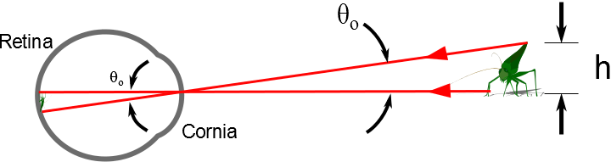

Slide 4
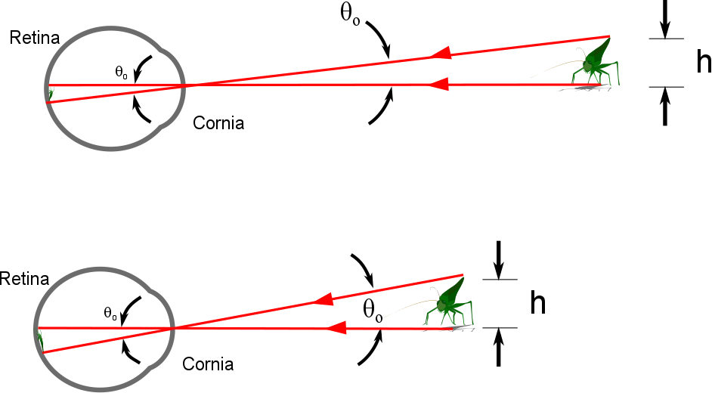

Slide 5
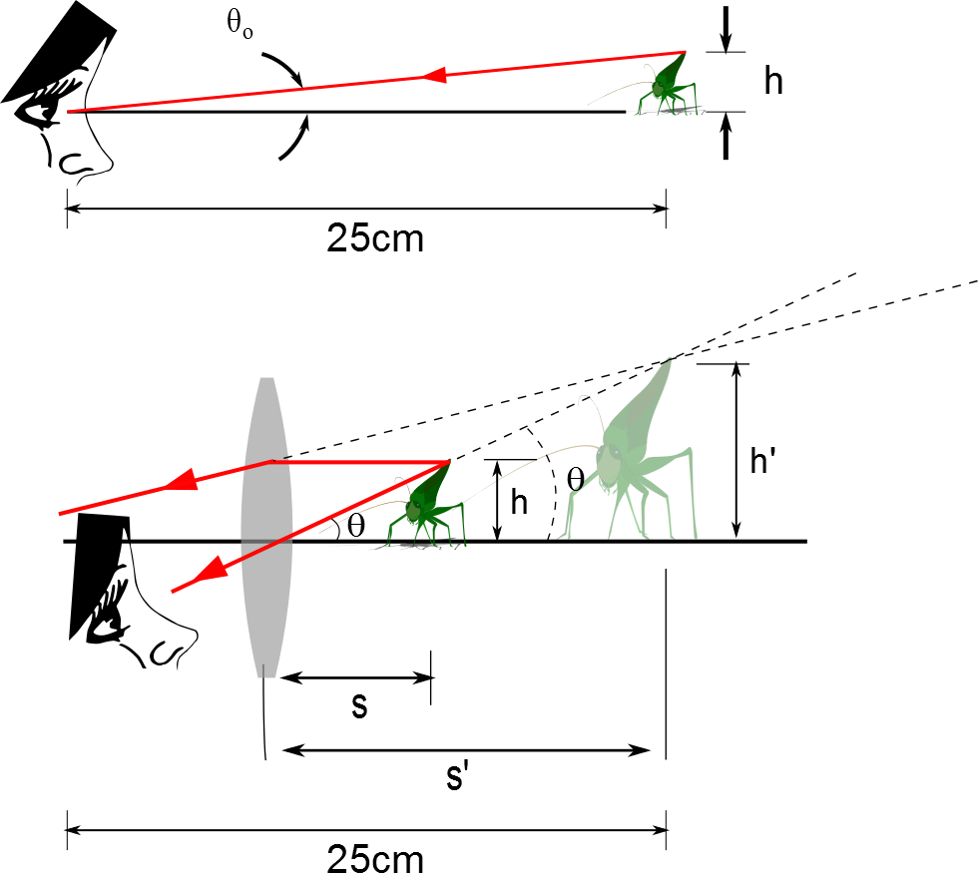
The Size of a Magnified Image
When an object is placed at the near point, the angle subtended is a maximum
The near point is about 25 cm
When the object is placed near the focal point of a converging lens, the lens forms a virtual, upright, and enlarged image

Slide 6
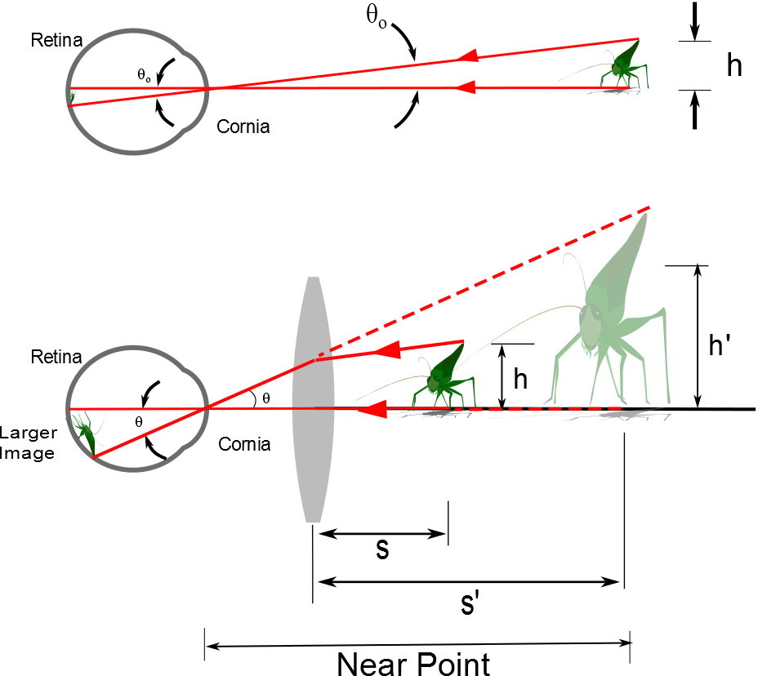
d

Slide 7
Angular Magnification
Angular magnification is defined as
The angular magnification is at a maximum when the image formed by the lens is at the near point of the eye
s’ = - 25 cm
Calculated by

Slide 8
Angular Magnification, cont.
The eye is most relaxed when the image is at infinity
Although the eye can focus on an object anywhere between the near point and infinity
For the image formed by a magnifying glass to appear at infinity, the object has to be at the focal point of the lens
The angular magnification is

Slide 9
Magnification by a Lens
With a single lens, it is possible to achieve angular magnification up to about 4 without serious aberrations
With multiple lenses, magnifications of up to about 20 can be achieved
The multiple lenses can correct for aberrations

Slide 10
The Compound Microscope

Slide 11
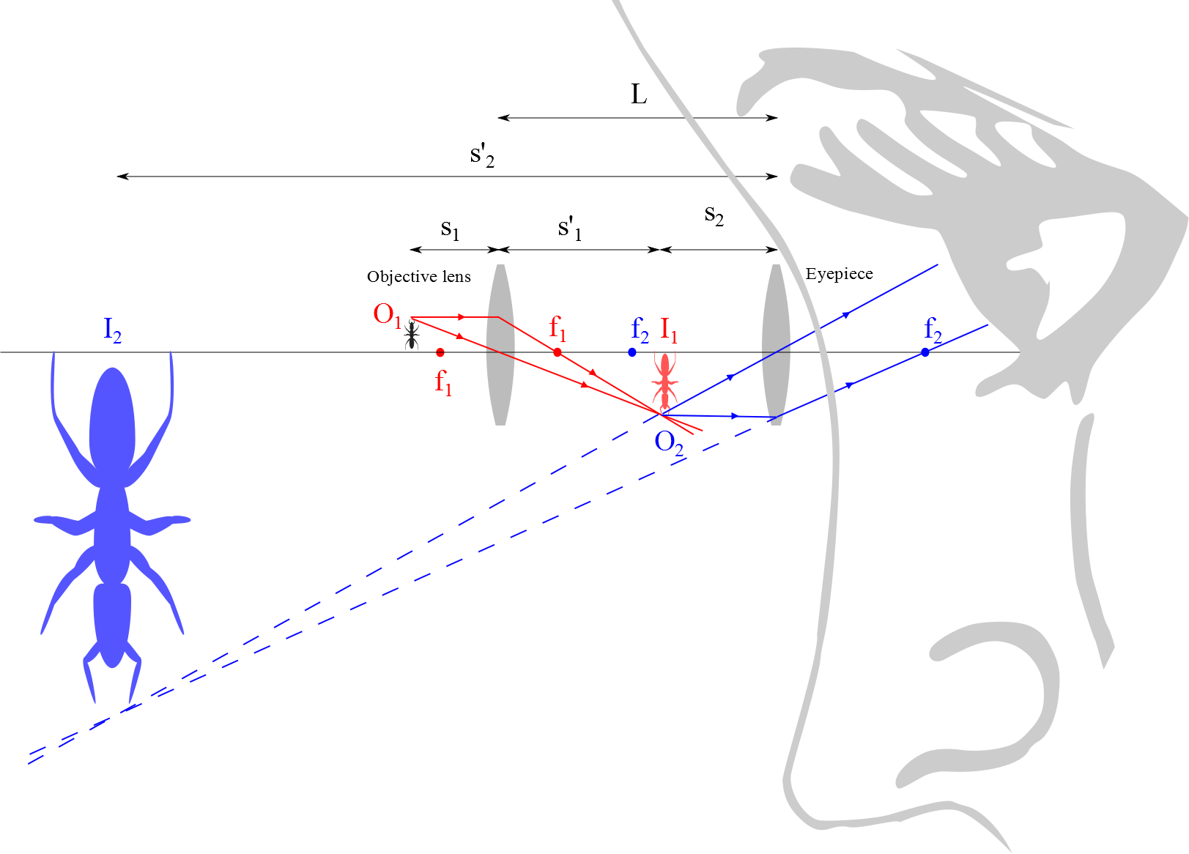
Compound Microscope

Slide 12
The telescope

Slide 13
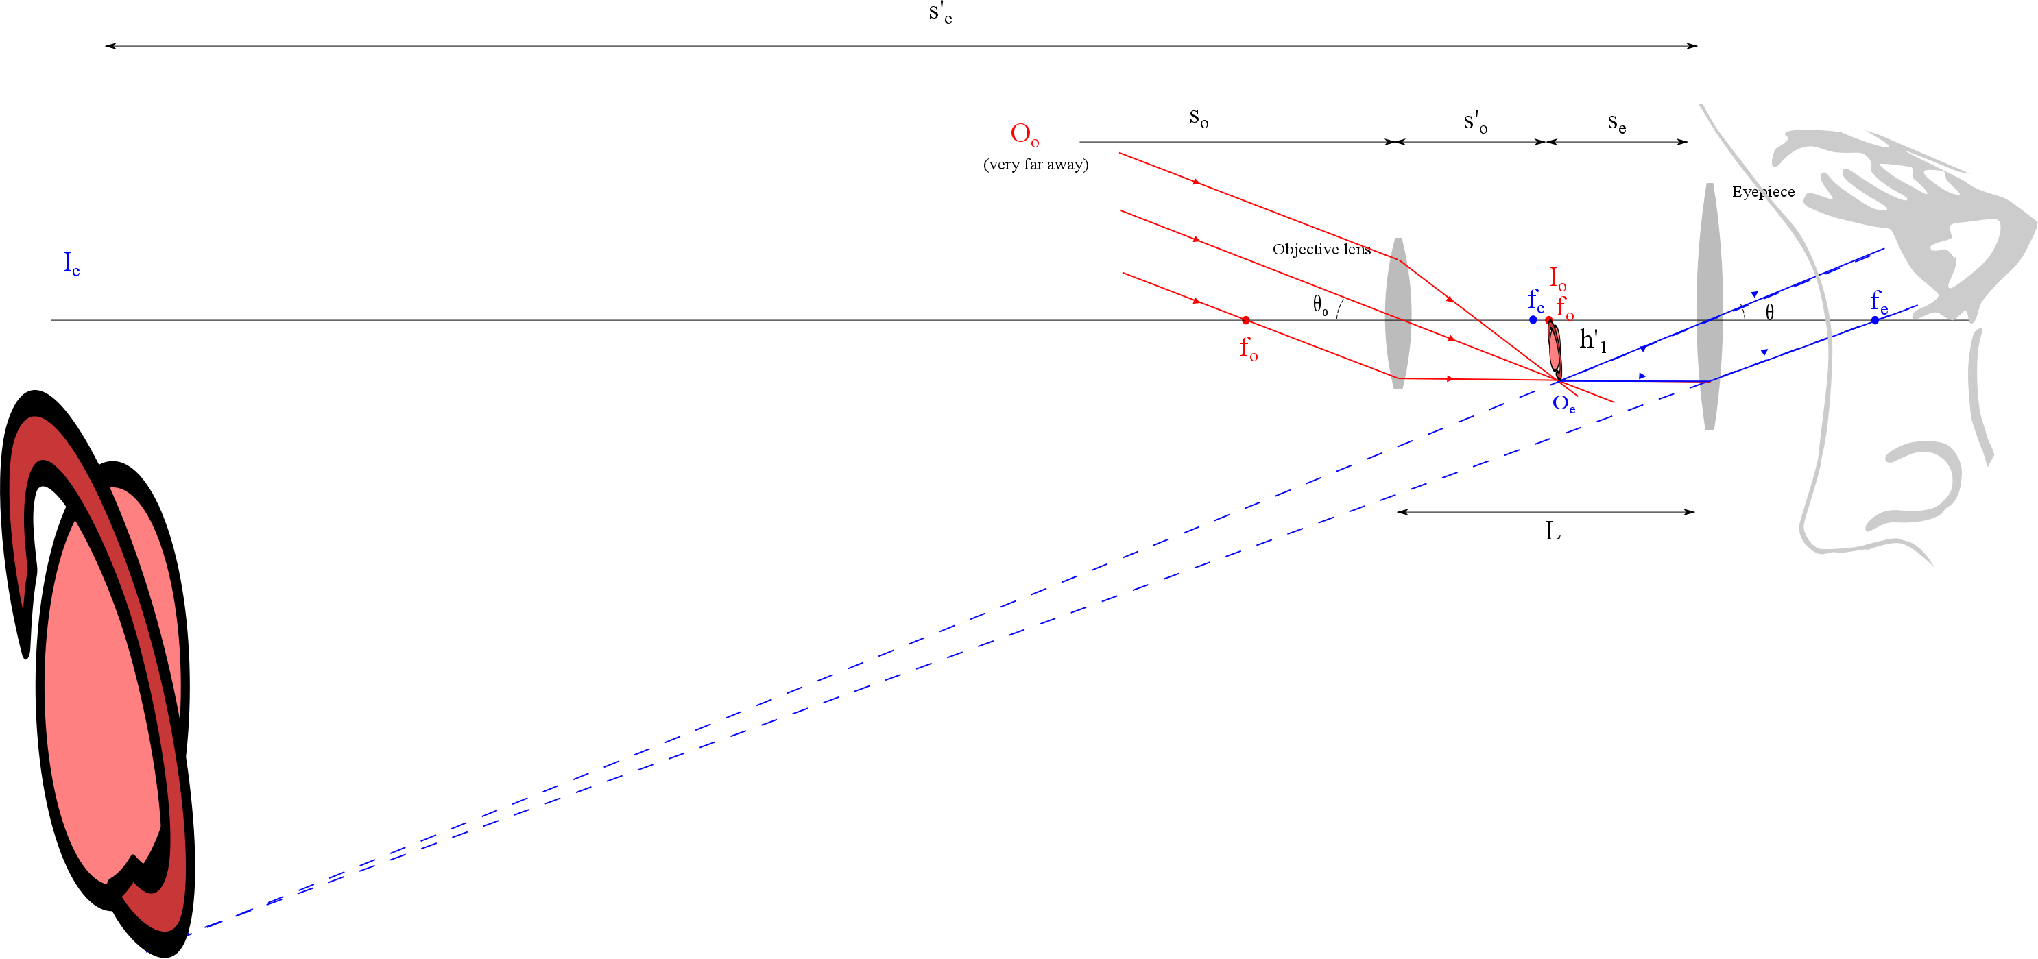

Slide 14
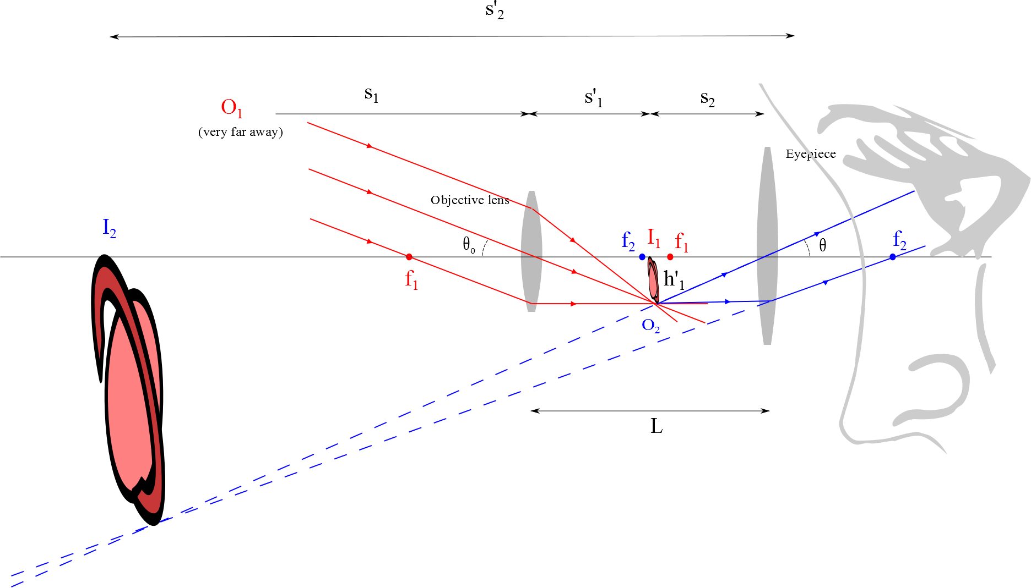
Refracting Telescope

Slide 15
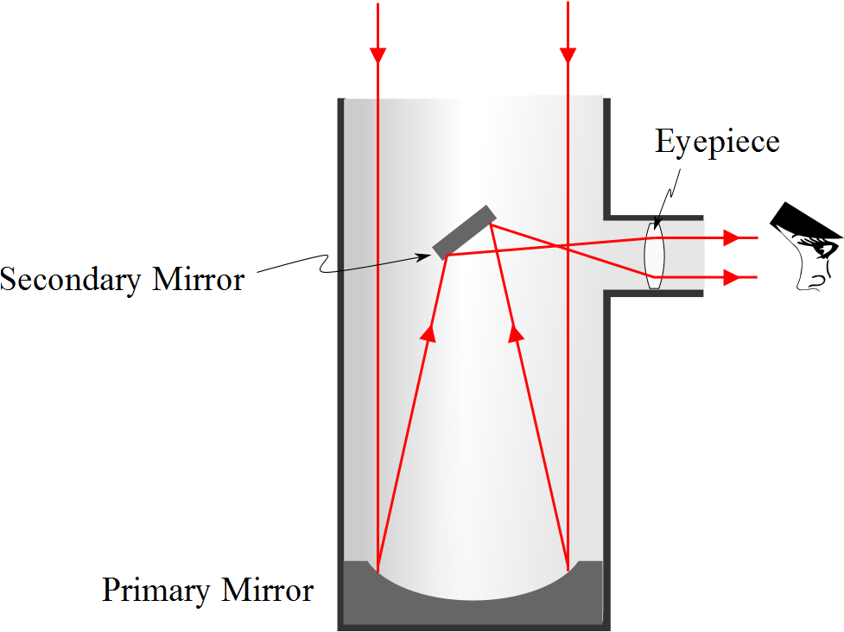
Reflecting Telescope: Newtonian

Slide 16
Examples of Telescopes
Reflecting Telescopes
Largest in the world are the 10-m diameter Keck telescopes on Mauna Kea in Hawaii
Each contains 36 hexagonally shaped, computer-controlled mirrors that work together to form a large reflecting surface
Refracting Telescopes
Largest in the world is Yerkes Observatory in Williams Bay, Wisconsin
Has a diameter of 1 m

Slide 17
Resolution

Slide 18
Question 223.19.1
Resolution is
The ending argument in a debate
The ability to distinguish separate point sources in an optical image
The distance between bright fringes in a diffraction pattern
The distance between dark fringes in a diffraction pattern

Slide 19
Question 233.19.2
Cat’s eyes have pupils that can be modeled as vertical slits. At night, would cats be more successful in resolving
Headlights on a distant car
Vertically separated lights on the mast of a distant boat?

Slide 20
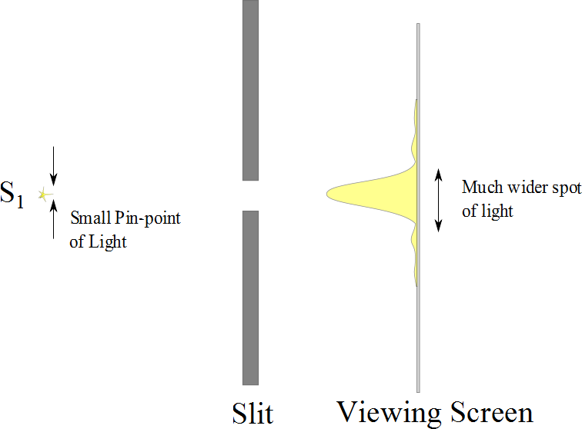

Slide 21
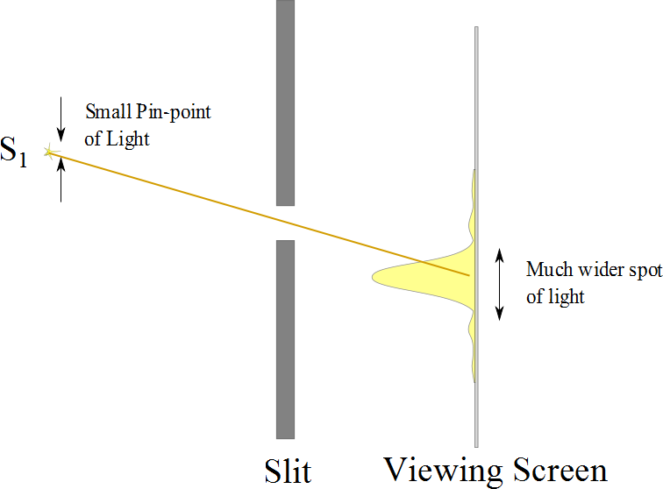

Slide 22
Resolution

Slide 23
Resolution
The ability of optical systems to distinguish between closely spaced objects is limited because of the wave nature of light
If two sources are far enough apart to keep their central maxima from overlapping, their images can be distinguished
The images are said to be resolved
If the two sources are close together, the two central maxima overlap and the images are not resolved

Slide 24
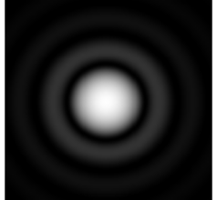

Slide 25
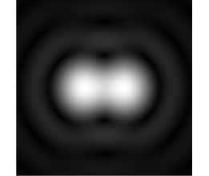

Slide 26
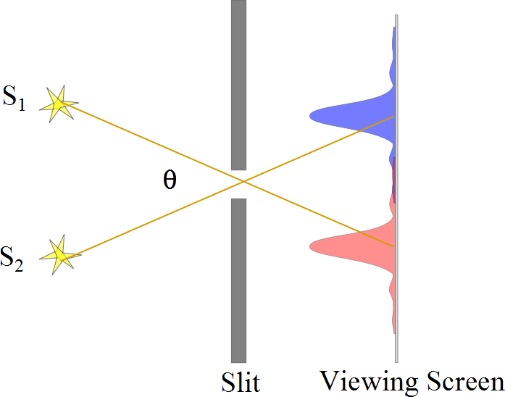
Resolved Images, Example

Slide 27
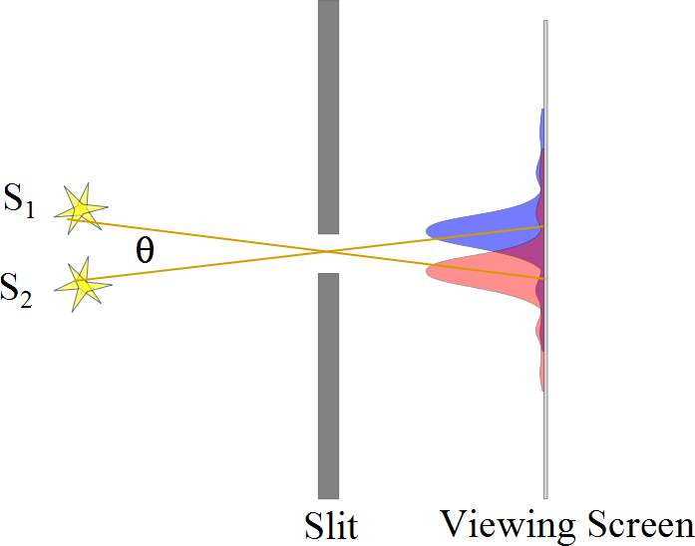
Barely Resolved, Example

Slide 28
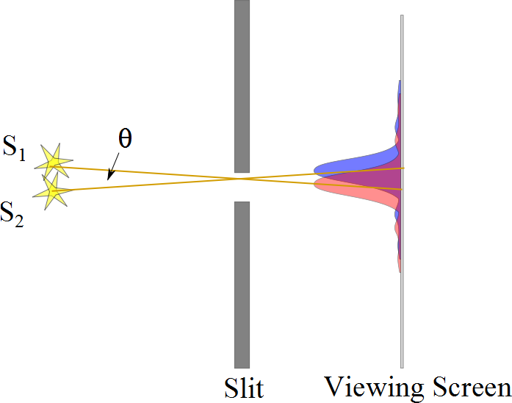
Images Not Resolved, Example

Slide 29
Resolution
The ability of optical systems to distinguish between closely spaced objects is limited because of the wave nature of light
If two sources are far enough apart to keep their central maxima from overlapping, their images can be distinguished
The images are said to be resolved
If the two sources are close together, the two central maxima overlap and the images are not resolved

Slide 31
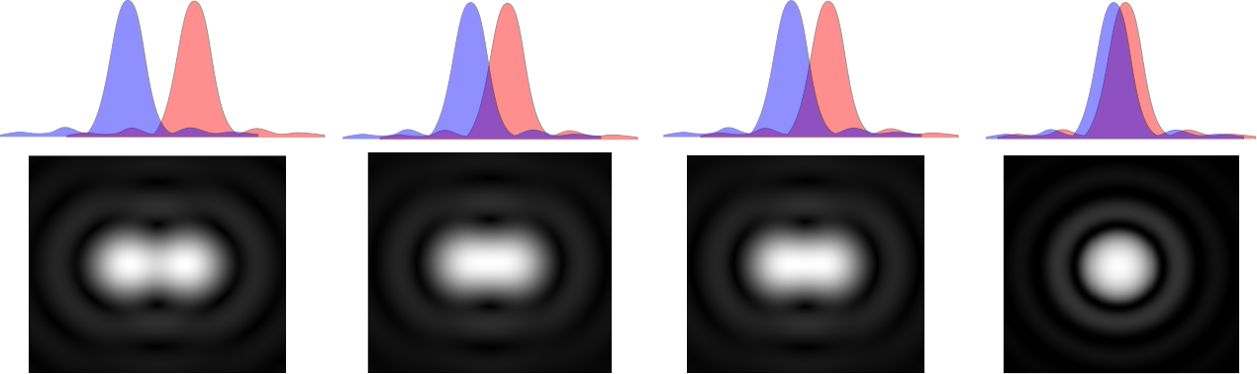

Slide 33
Resolution, Rayleigh’s Criterion
When the central maximum of one image falls on the first minimum of another image, the images are said to be just resolved
This limiting condition of resolution is called Rayleigh’s criterion

Slide 34
Resolution, Rayleigh’s Criterion, Equation
The angle of separation, θ_{min}, is the angle subtended by the sources for which the images are just resolved
Since λ << a in most situations, sin θ is very small and sin θ ≈ θ
Therefore, the limiting angle (in rad) of resolution for a slit of width a is
To be resolved, the angle subtended by the two sources must be greater than θ_{min}

Slide 35
Circular Apertures
The diffraction pattern of a circular aperture consists of a central bright disk surrounded by progressively fainter bright and dark rings
The limiting angle of resolution of the circular aperture is
D is the diameter of the aperture

Slide 36
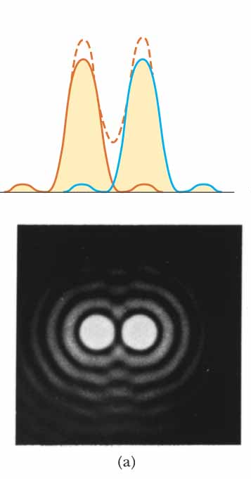
Circular Apertures, Well Resolved
The sources are far apart
The images are well resolved
The solid curves are the individual diffraction patterns
The dashed lines are the resultant pattern

Slide 37
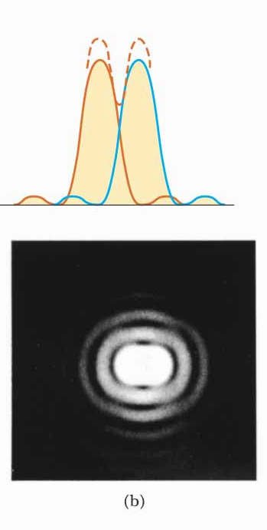
Circular Apertures, Just Resolved
The sources are separated by an angle that satisfies Rayleigh’s criterion
The images are just resolved
The solid curves are the individual diffraction patterns
The dashed lines are the resultant pattern

Slide 38
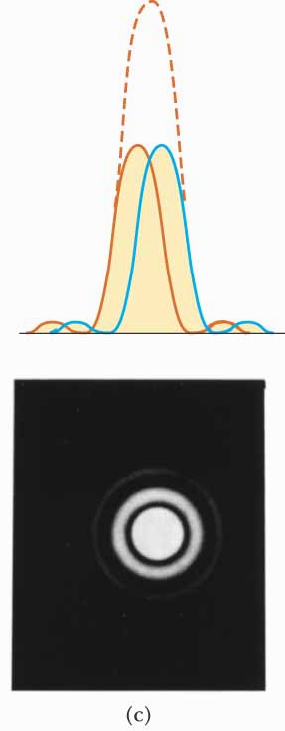
Circular Apertures, Not Resolved
The sources are close together
The images are unresolved
The solid curves are the individual diffraction patterns
The dashed lines are the resultant pattern

Slide 39
Completely Resolved
Rayleigh Criterion
Sparrow Criterion
Unresolved

Slide 40
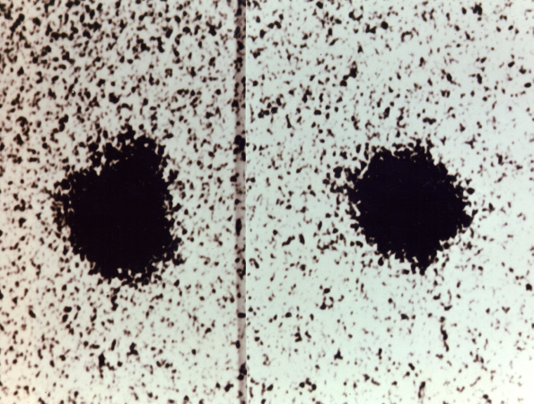
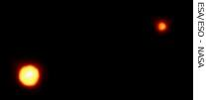
Resolution, Example
Charon
Pluto
Pluto and its moon, Charon
Left: Earth-based telescope is blurred
Right: Hubble Space Telescope clearly resolves the two objects

